Slide 1
Sensor Interfacing with Wi-SUN Explorer Kit (EFR32ZG28)

Slide 2
Step 1: Creating Application Monitoring Project
Create Wi-SUN Node Monitoring Application
Goto .slcp file
Click on Software Component
Remove “Wi-SUN OTA DFU” Component
Add “CoAP” Component
Note:- This steps are same as that of the Wi-SUN node monitoring application.

Slide 3
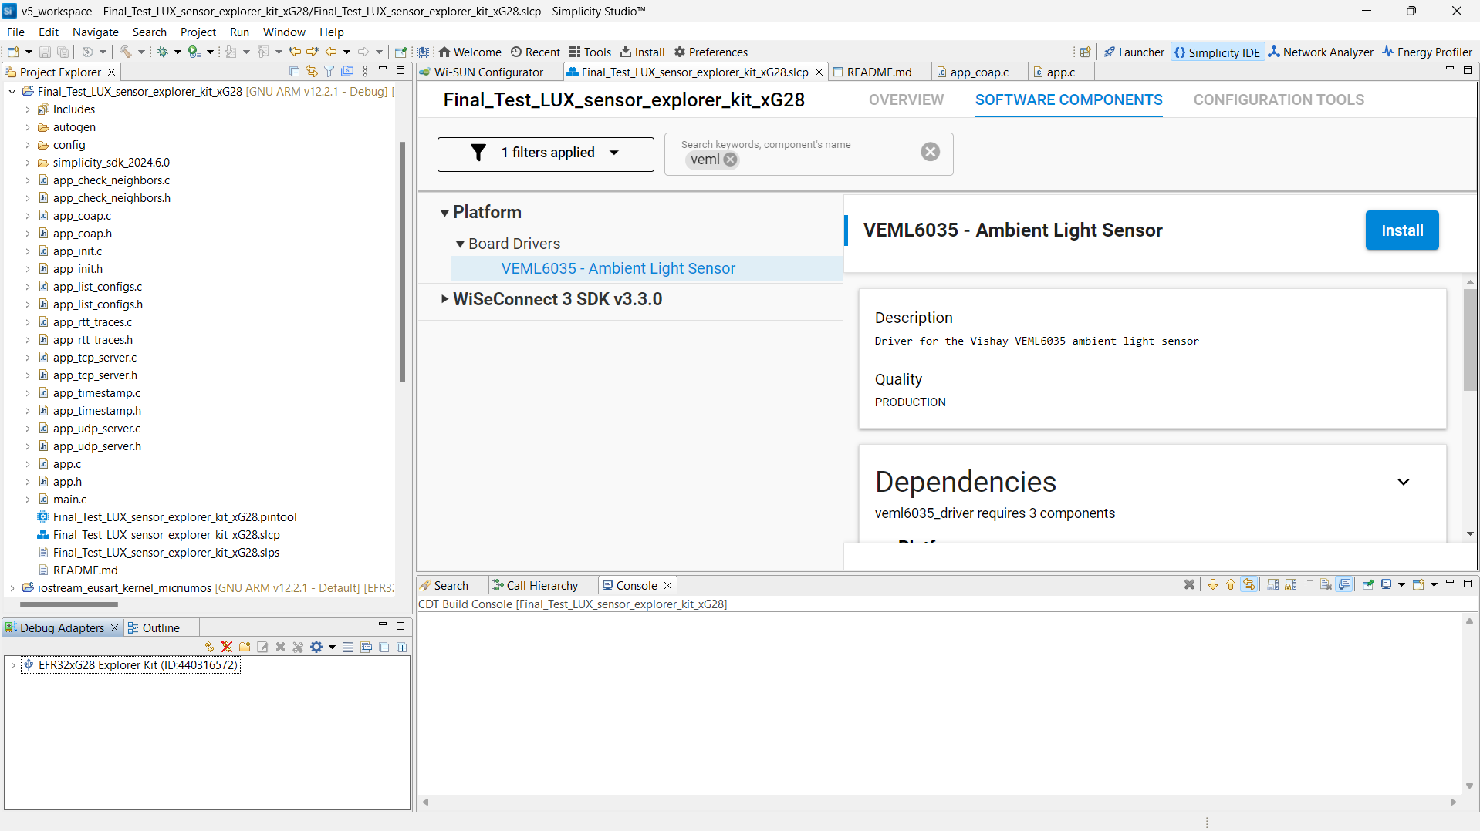
Step 2: Add Software components for Sensor Interfacing.
1.In Software Components
Search for veml6035
Click on Install.

Slide 4
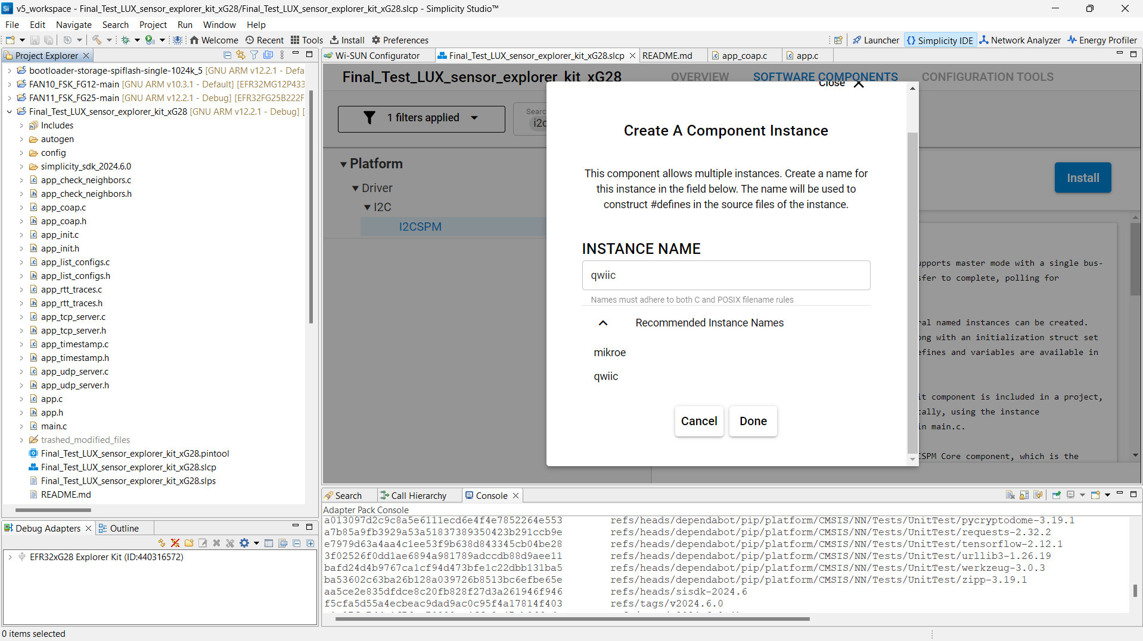
2.Click on Install
1.Search for
I2CSPM
3. Select [ Qwiic ] in Recommended Instance Names.
4. Click on DONE

Slide 5
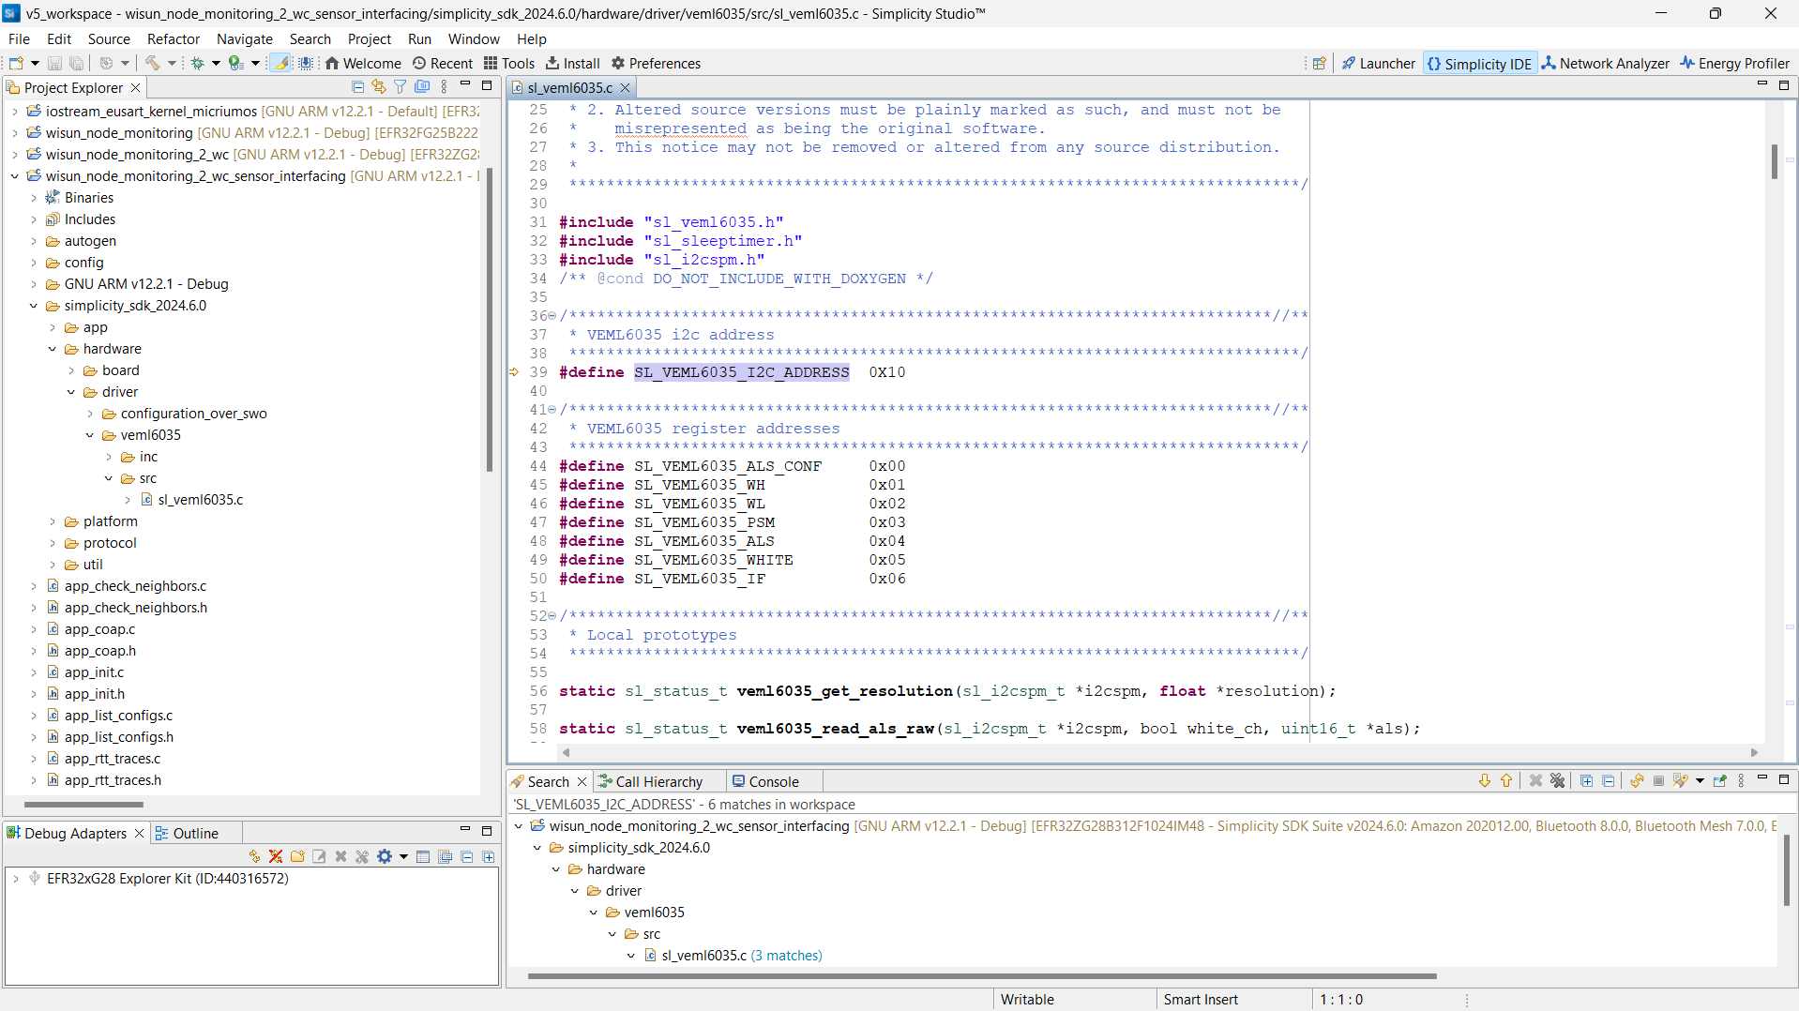
Step 3 : Add few lines of code
Note: while editing the [ sl_veml6035.c ] file it will ask you to save a copy.
So pls make sure to save a copy.
2. In [ sl_veml6035.c ] file .You can change the I2C address as per your sensor I2C address.
3. [In our case it is 0x10].
1.Navigate to this location
You will find
[ sl_verml6035.c ] file
Double Click on it.

Slide 6
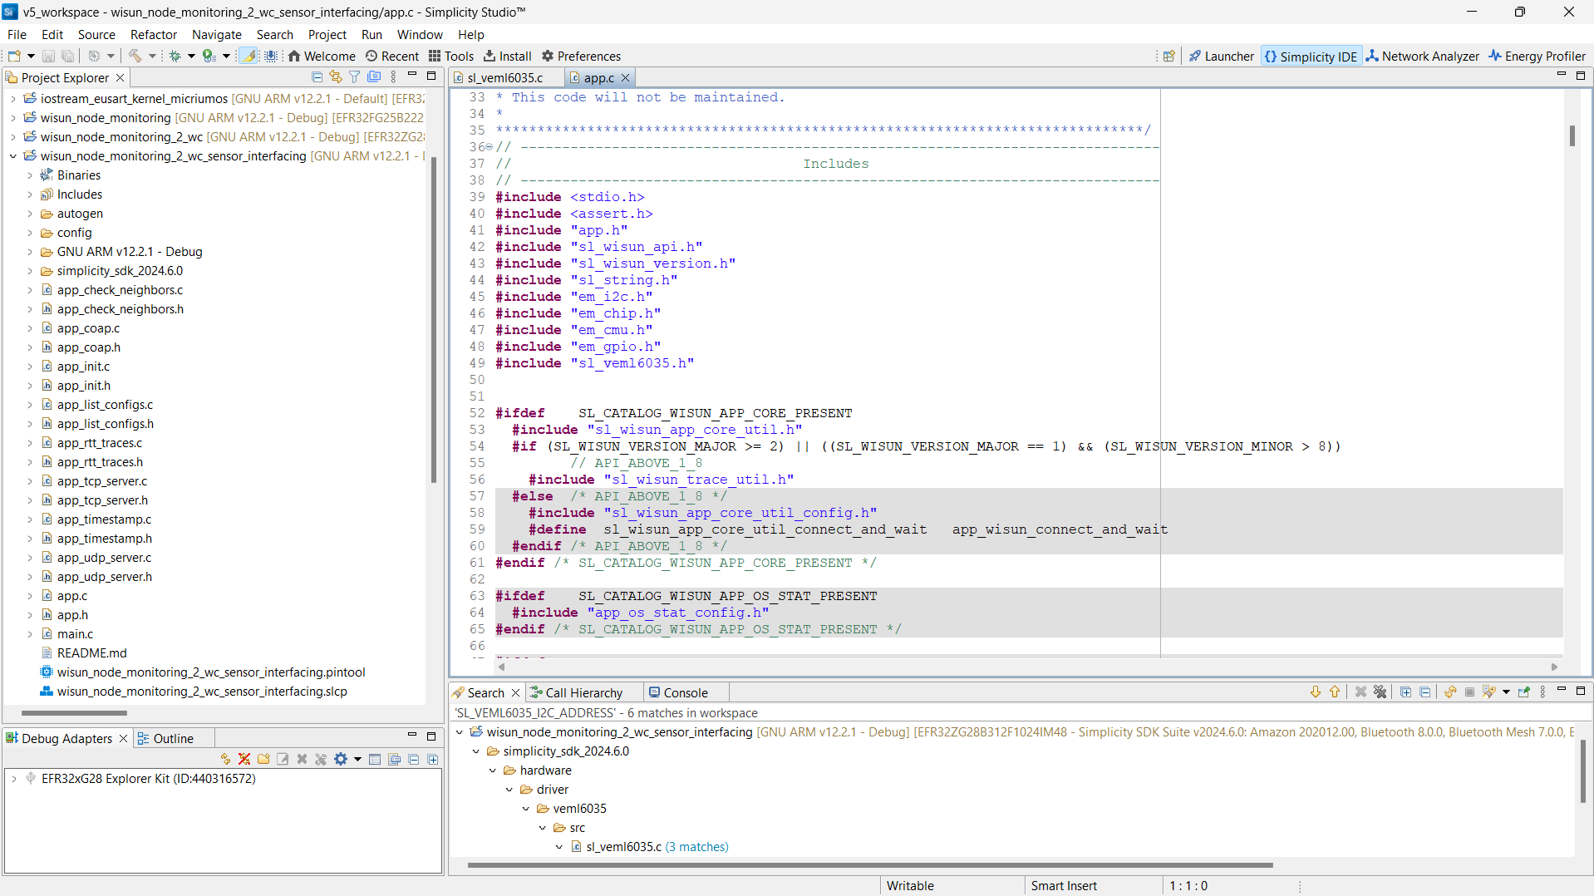
You must add the below given header file in [ app.c ] file .
#include "em_i2c.h"
#include "em_chip.h"
#include "em_cmu.h"
#include "em_gpio.h"
#include "sl_veml6035.h"

Slide 7
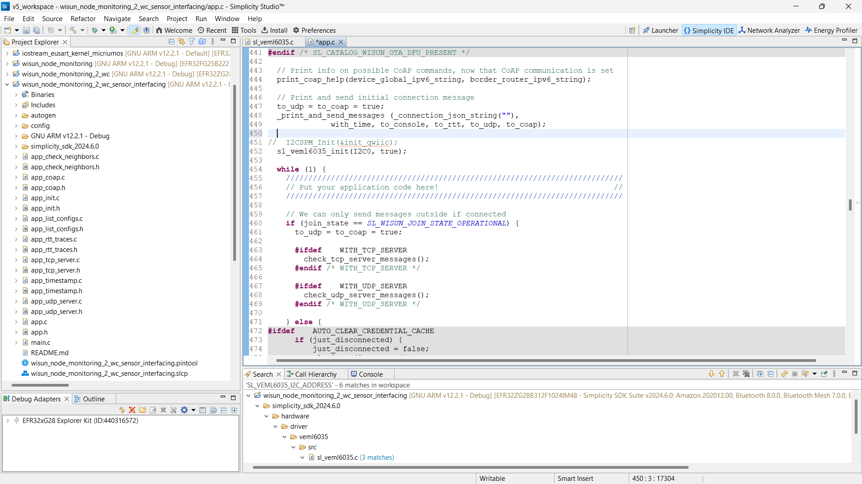
In [app.c] file
Add [ sl_veml6035_init(I2C0, true); ]
Above while loop

Slide 8
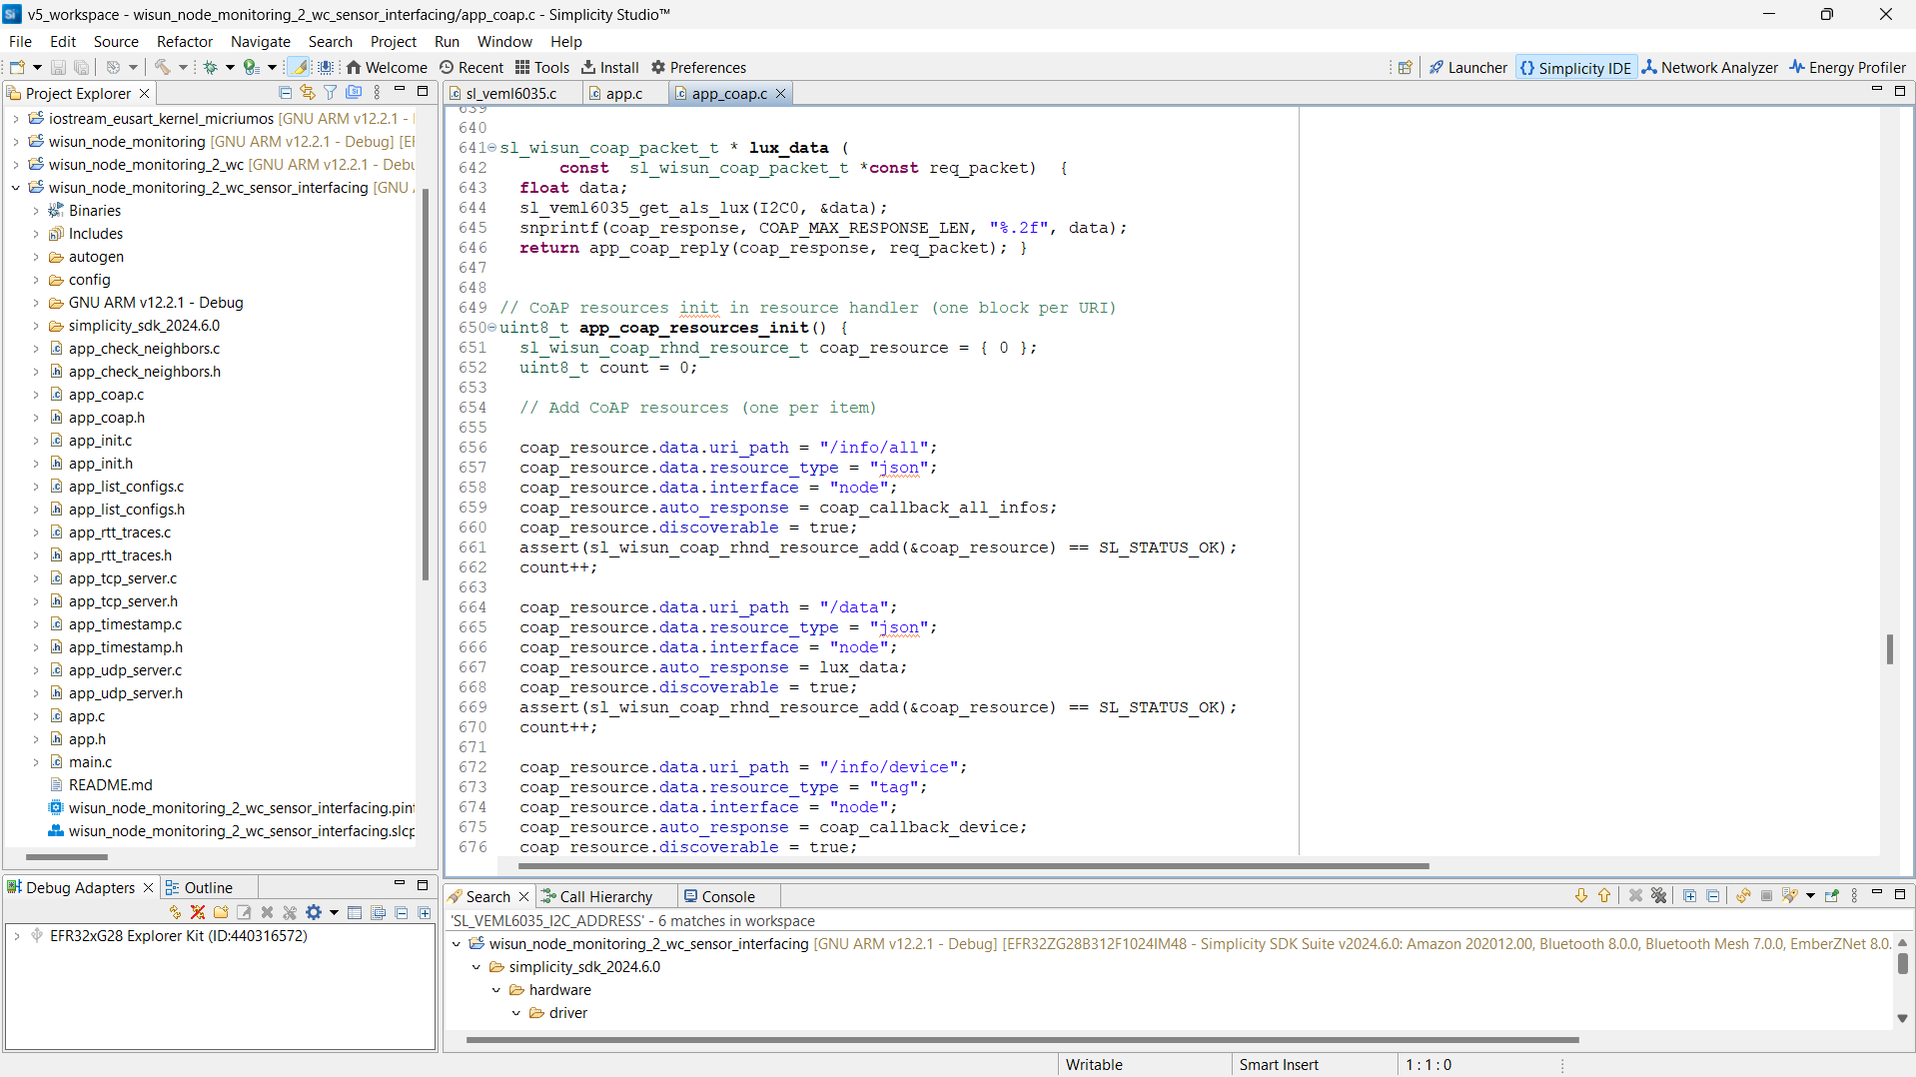
In [ app_coap.c ] file You must add the below given code.
sl_wisun_coap_packet_t * lux_data (
const sl_wisun_coap_packet_t *const req_packet) {
float data;
sl_veml6035_get_als_lux(I2C0, &data);
snprintf(coap_response, COAP_MAX_RESPONSE_LEN, "%.2f", data);
return app_coap_reply(coap_response, req_packet); }
coap_resource.data.uri_path = "/data";
coap_resource.data.resource_type = "json";
coap_resource.data.interface = "node";
coap_resource.auto_response = lux_data;
coap_resource.discoverable = true; assert(sl_wisun_coap_rhnd_resource_add(&coap_resource) == SL_STATUS_OK);
count++;

Slide 9
Step 4: Upload [.s37] file and check the data on oneM2M
After That Just Build the Project and Flash [ .s37 ] file to the Board

